Slide 1
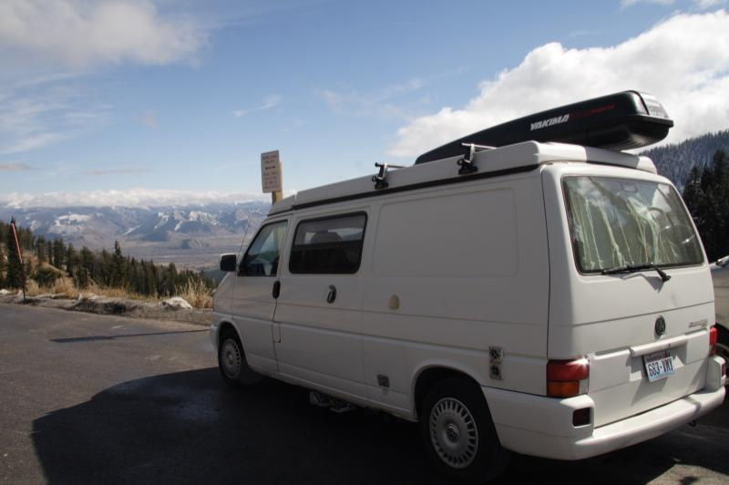
Road Trippin’ USA
August 2007
By: Audrey Sniezek & Claudia Béland

Slide 2
Why Roadtrip?
Experience other climbing areas
Meet other climbers across the nation
Climb more than is achievable ‘at home’
Experience the life of a vagabond ☺
Find out if the nomadic life is for you!

Slide 3
1 year?
What are your climbing goals?
How many places do you hope to explore?
Is there a financial or other obligation restricting you?
Things to think about
Injuries
Family emergencies
Poor weather
Social tensions

Slide 4
Traveling with Friends
Do it!
Pro
Offset costs (food, camping, fuel)
Established social circle
Safety in numbers
Automatic variety due to varying abilities
More possibilities in general

Slide 5
Traveling with Friends
Cons
Different goals
Confined social network
Lack of spontaneity
Suggestion:
Subdivide

Slide 6
Where to go?
What kind of climbing?
Trad?
Sport?
Boulder?
Approx. how long in each area?
Explore the ‘classics’
‘Project’
Weather, goals, scene, attitude affect length of stay

Slide 7
Accommodations
Car/van, tent, hotel, rental, cabin, Walmart
Budget
Availability
Tolerance
Weather
Campground restrictions (e.g. no fires)
Resources
Guidebooks
Local climbers

Slide 8
Budget
 | Mo. Average | Mo. Maximum | Mo. Minimum | Budget
Food | $ 380.79 | $ 554.55 | $ 158.90 | $ 300.00
Fuel | $ 453.26 | $ 717.07 | $ 243.00 | $ 600.00
Vehicle Expenses | $ 438.44 | $ 1,317.89 | $ 77.86 | $ 200.00
Misc | $ 442.11 | $ 930.30 | $ 28.52 | $ 50.00
Unusual | $ 345.18 | $ 865.75 | $ 18.17 | $ 100.00
Lodging | $ 210.78 | $ 297.94 | $ 168.96 | $ 240.00
Entertainment | $ 111.57 | $ 450.34 | $ - | $ 50.00
Sample total | $ 2,382.13 | $ 5,133.84 | $ 695.41 | $1,540.00
Emergency Reserves |  |  |  | $5000

Slide 9
Goals
Have Fun!
Be flexible
Respect Group vs. Individual
Create Non-climbing
Explore Personal (physical fitness, eating healthy, etc.)
The trip is what you make it! ☺

Slide 10
Internet
Libraries
Internet café
Truck stops (e.g. Triple J)
Some towns are better equipped than others
Be careful about poaching!
It is a criminal offense, if caught

Slide 11
Lessons Learned
Budget!
Budget for the unexpected
Flexibility (go with the flow)
Less is more…really
Experiment with Resources
Shower at truck stop
Ice from McDonalds
When to trust/not trust people
Pets are not allowed in all places (NP)

Slide 12
Shockers!
Dumpster diving
Bags of apples thrown out, one bad
Not everywhere!
Sleeping in parking lots
Bathing in sinks
Things you wouldn’t do at home but are ‘fun’ to try on the road. ☺

Slide 13
What to pack
Medications!
Emergency medication (e.g antibiotic)
National mobile plan or pre-paid sim
Layers (cool, warm and rain weather clothes)
Games (one or two, be selective)
Your favorite ‘something’
Less is better

Slide 14
Things to do before you go
Proper Insurance (medical and vehicle)
Service your car/van!
Electronic bill pay (bank and creditors)
Someone checking your mail
Sublet and arrange for management
Map out the route
Research the areas (amenities, distance to city, ect).

Slide 15
Enjoy Your Trip!
Thank you

Slide 16
Mexico?
Title and Insurance papers for vehicle
Buy Mexican Insurance (best $ online)
Passport
Credit card (or lots of Pesos!)
Don’t grocery shop before crossing the border!

